Slide 1

LIBRARY
APPLICATION
Presented By
A.Bhuvana
R.Karthika
K.Kamali
M.Ramya
K.Shilpa

Slide 2

OBJECTIVE
To collect, store, organize, retrieve and make available the information sources to the information users.

Slide 3

ABSTRACT
The project “Library Application” is developed in “Spring Boot using JAVA”.
A library Application that provides following facilities login, register, add category, add / remove book, search / issue book, return book and fine.
Library system keeps track of all the transaction that takes place in the library . Starting from book transaction to financial transaction.

Slide 4
PROPOSED SYSTEM
Helps in knowing the present status of the book.
Shows the borrowing date and returning date of the book i.e) keep track of the book moment.
Shows the systematic availability of the book.
Maintains records of the new book.
One can search any book by querying.

Slide 5
REQUIREMENTS
Hardware Requirements
Processor: AMD
RAM: 1GB or more
Hard Drive: 1GB or more
Software Requirements
Operating System: Windows, Linux
User Interface: HTML, CSS
Programming Language: Core Java
Web Application: Servlets
Database: MYSQL
IDE/Workbench: Spring Tool Suite
Server Deployment: Tomcat
Technology: Spring Boot

Slide 6


SPRING BOOT
Tool that makes developing web application and microservices with Spring Framework faster and easier through three core capabilities:
Autoconfiguration
An opinionated approach to configuration
The ability to create standalone application
ADVANTAGES
Fast and easy development of Spring-based applications.
The ability to create standalone applications.

Slide 7
CONTROLLER
Responsible for processing incoming REST API requests, preparing a model, and returning the view to be rendered as a response.
SYNTAX
@Controllerpublic class UserController { @RequestMapping("/user") public String getUser() { }}
PURPOSE
Indicates that a particular class serves the role of a controller.
Controls the flow of the data.

Slide 8
REPOSITORY
Mechanism for encapsulating storage, retrieval, and search behavior which emulates a collection of objects.
SYNTAX
public interface PagingAndSortingRepository<T, ID extends Serializable> extends CrudRepository<T, ID> {}
PURPOSE
Allows you to populate data in memory that comes from the database in the form of the domain entities.

Slide 9
CRUD REPOSITORY
Provides generic Crud operation on a repository.
Defined in the package org.springframework.data.repository and It extends the Spring Data.
SYNTAX
public interface DepartmentRepository extends CrudRepository<Department, Long> {}

Slide 10
SPRING ANNOTATIONS
Annotations are a form of metadata that provides data about a program.
Used to provide supplemental information about a program.
Does not have a direct effect on the operation of the code they annotate.

Slide 11
ANNOTATIONS
AUTOWIRED
Used for dependency injection.
All loaded beans are eligible for auto wiring to another bean.
The annotation @Autowired in spring boot is used to auto-wire a bean into another bean.
PURPOSE
Enables you to inject the object dependency implicitly.

Slide 12
BEAN
The objects that form the backbone of your application and that are managed by the Spring IoC container are called beans.
Indicates that a method produces a bean to be managed by Spring.
PURPOSE
Mark a method as one that creates a bean and Spring will then add it to the context for us.

Slide 13
ENTITY
Specifies that the class is an entity and is mapped to a database table.
TABLE
Specifies the name of the database table to be used for mapping.
The entities are the persistence objects stores as a record in the database.
ID
Specifies the primary key of an entity .
GeneratedValue
Provides for the specification of generation strategies for the values of primary keys.

Slide 14
MAPPING
Allows us to access and persist data between Java object/ class and relational database.
Follows Object-Relation Mapping (ORM). It is a set of interfaces.
ONE-TO-MANY
Declares the mapped By element to indicate the entity that owns the bidirectional relationship.
MANY-TO-ONE
Many instances of this entity are mapped to one instance of another entity – many items in one cart.

Slide 15
TYPES OF MAPPING
REQUEST MAPPING
@Controller@RequestMapping("/users")public class UserController { @RequestMapping("/user") public String getUser() { }}
GET MAPPING
@GetMapping("/get")public @ResponseBody ResponseEntity<String> get() { return new ResponseEntity<String>("GET Response", HttpStatus.OK);}
PUT MAPPING
@PutMapping("/put")public @ResponseBody ResponseEntity<String> put() { return new ResponseEntity<String>("PUT Response", HttpStatus.OK);}

Slide 16
POST MAPPING
@PostMapping("/post")public @ResponseBody ResponseEntity<String> post() { return new ResponseEntity<String>("POST Response", HttpStatus.OK);}
DELETE MAPPING
@DeleteMapping("/delete")public @ResponseBody ResponseEntity<String> delete() { return new ResponseEntity<String>("DELETE Response", HttpStatus.OK);}

Slide 17

APPLICATION PROPERTIES
Used to keep ‘N’ number of properties in a single file to run the application in a different environment.
Located in the src/main/resources directory.
The code for sample application.properties file is given by
server.port = 9090
spring.application.name = demoservice

Slide 18

HIBERNATE
Mapping from Java classes to database tables, and mapping from Java data types to SQL data types.
ADVANTAGES
Open Source and Lightweight.
Database Independent Query.
Automatic Table Creation.
Provides Query Statistics and Database Status.

Slide 19
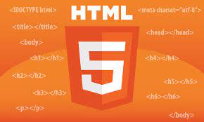
HTML
The HyperText Markup Language
Standard markup language for documents designed to be displayed in a web browser.
Assisted by technologies such as Cascading Style Sheets (CSS)

Slide 20

CSS
Cascading Style Sheets (CSS)
Stylesheet language used to describe the presentation of a document written in HTML or XML .
Describes how elements should be rendered on screen, on paper, in speech, or on other media.

Slide 21
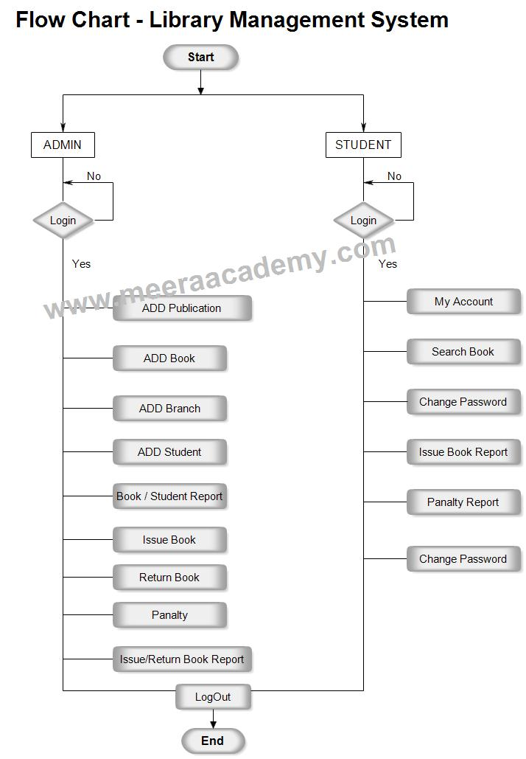
FLOW CHART

Slide 22
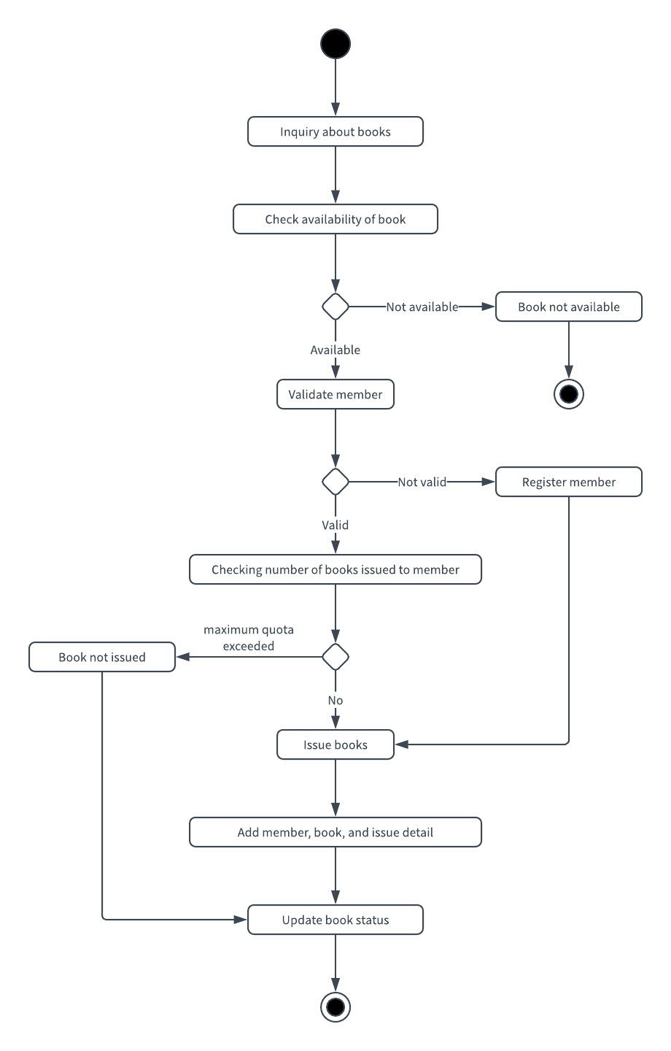
FLOW CHART

Slide 23
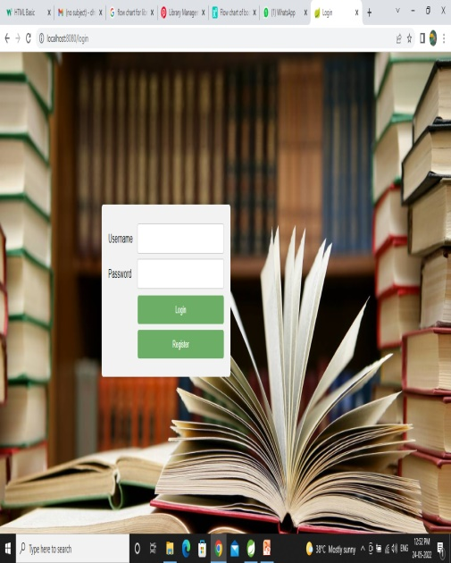
SNAP SHOTS

Slide 24
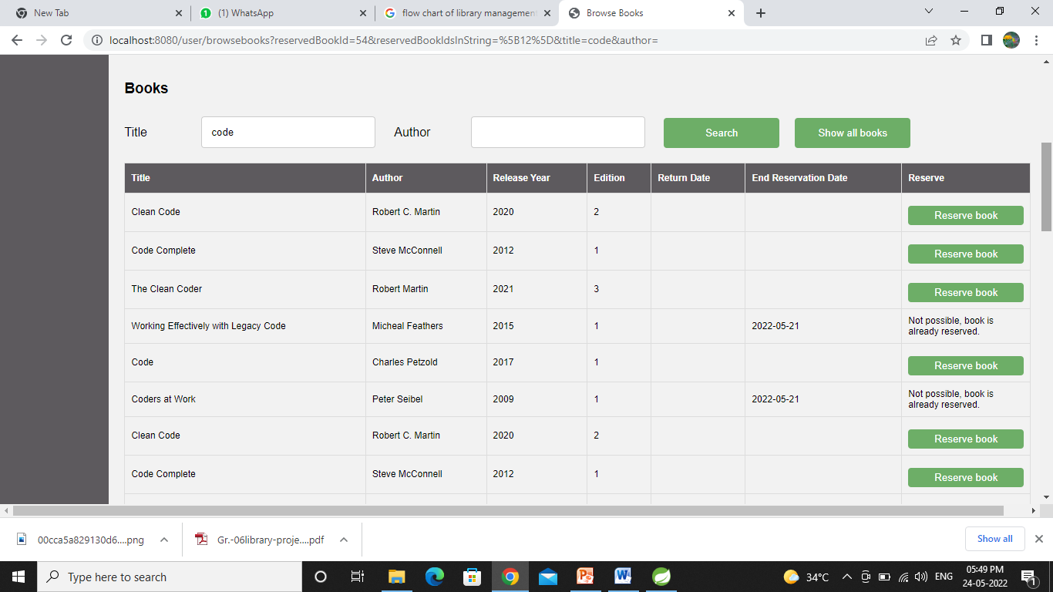
SNAP SHOTS

Slide 25
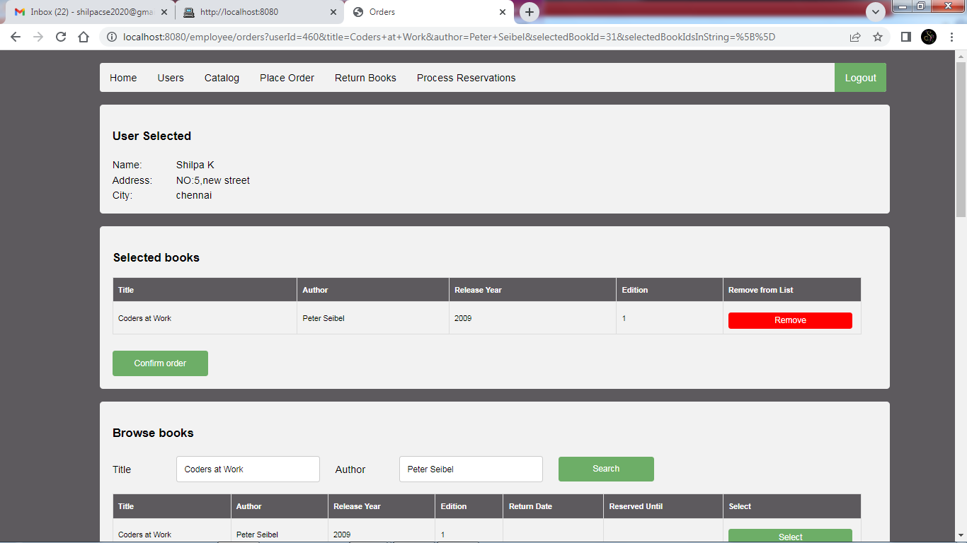
SNAP SHOTS

Slide 26
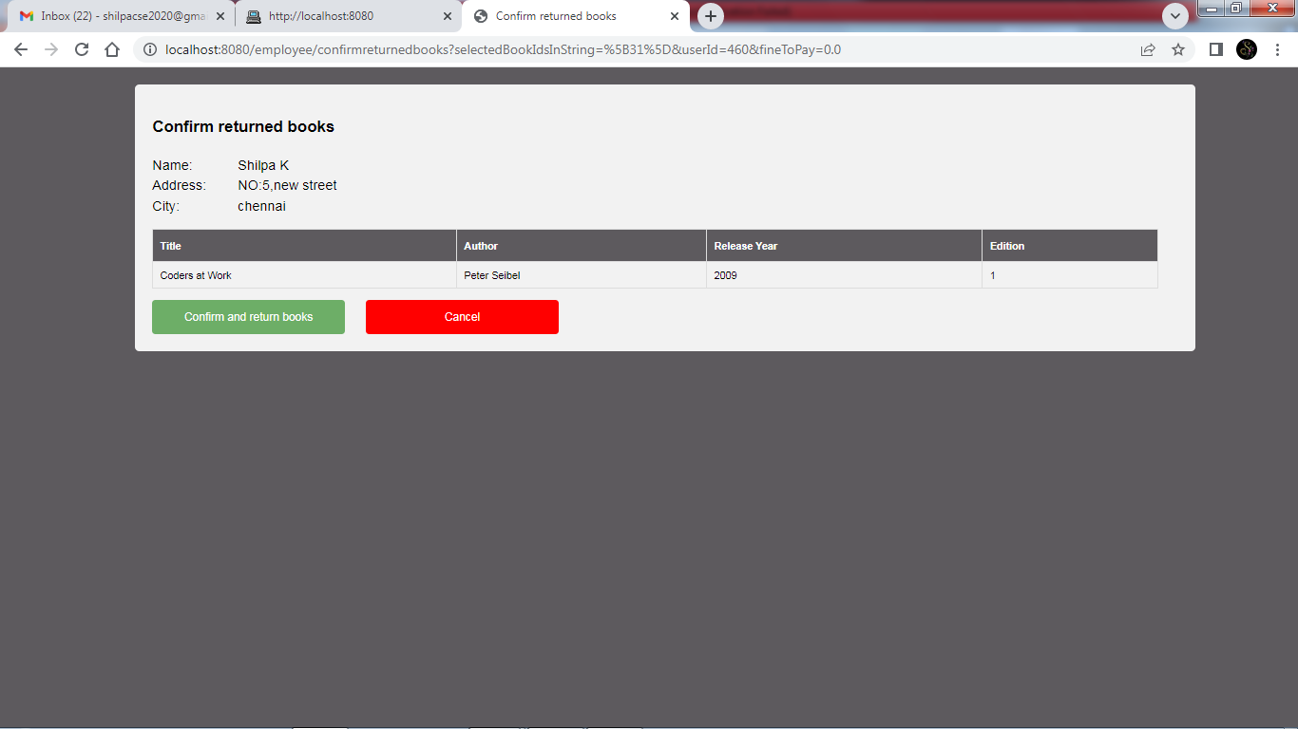
SNAP SHOTS

Slide 27
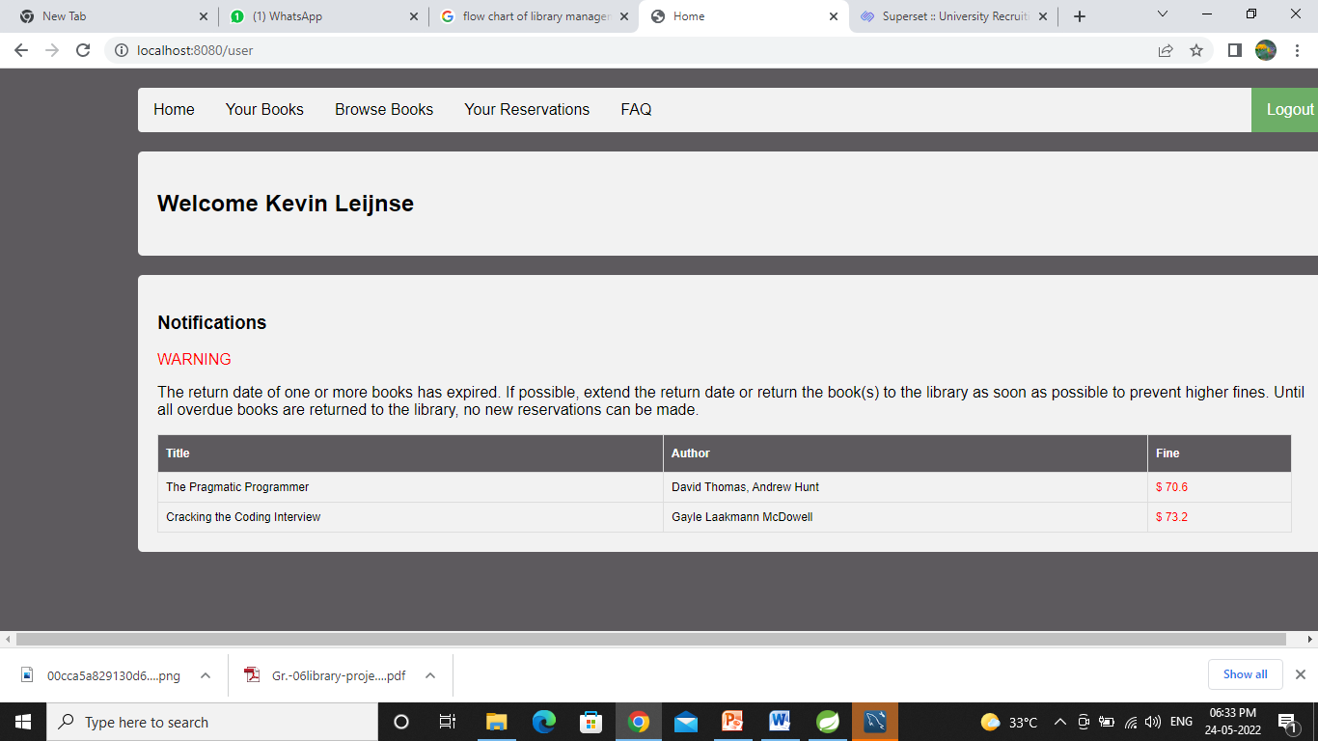
SNAP SHOTS

Slide 28
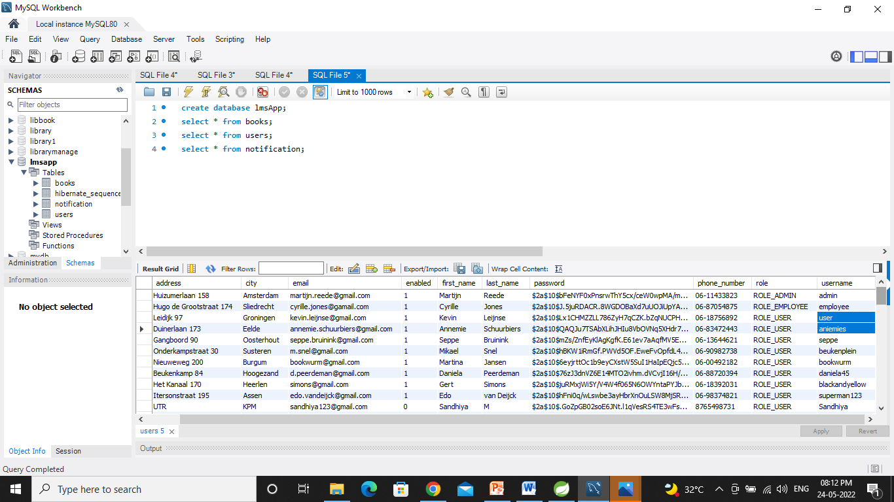
SNAP SHOTS

Slide 29

BENEFITS
It provides "better and efficient" service to members.
Reduce the workload of librarian.
Faster retrieval of information about the desired book.
Provide facility for proper monitoring reduce paper work and provide data security.
All details will be available on a click for both user and librarian and also stored in Database.

Slide 30
FUTURE SCOPE
To assist the staff in capturing the effort spent on their respective working areas.
Increasing facilities of this software.
In future we add printing option.

Slide 31

CONCLUSION
The entire implementation system mainly demonstrates the concept of a library management system. This project has been computed successfully and it is user friendly. The developed system perfectly met all the objectives conceived at the design phase of the system. This project helps the user from avoiding the manual stress in maintaining the records.

Slide 32
THANK YOU

